Slide 1
Lecture 33: Introduction to Java
CSC111: Introduction to CS through Programming
R. Jordan Crouser
Assistant Professor of Computer Science
Smith College
Material for this lecture based on:
http://interactivepython.org/runestone/static/java4python/index.html

Slide 2
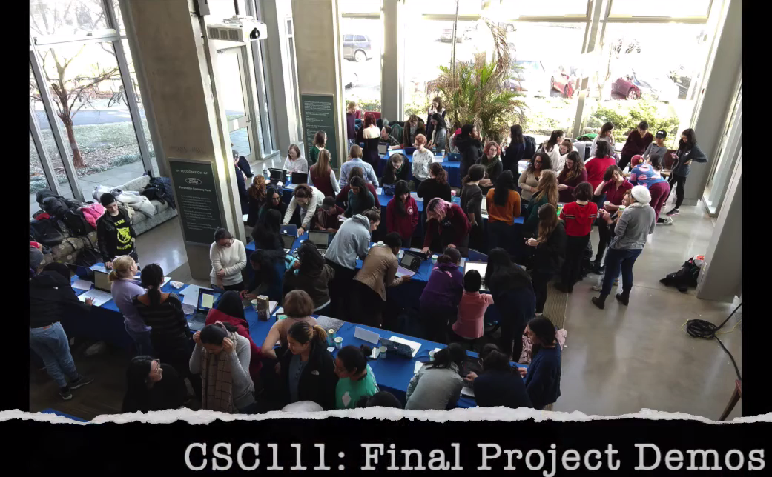
Final Project “Miniseries”
Typical semester: big reception in Ford Atrium where teams demonstrate their final projects to CS Department

Slide 3
Final Project “Presentations”
Typical semester: big reception in Ford Atrium where teams demonstrate their final projects (as seen in video)
Pandemic version:
Too many projects to do “live” presentations via Zoom
Instead, FP3: Prototype II will be a 5-minute video which we’ll combine to make a multi-part “miniseries”
The week following break will be fully asynchronous (you can watch the “episodes” at your convenience)

Slide 4
What to include in your video
A brief overview / description of your project
Describe the “big idea”
A sentence or two about the intended audience
Great place to include pictures of your paper prototype / persona
An overview of the code
Pull up your repl and give us a quick tour ☺
Did you use object-oriented programming, or something more function-oriented? Tell us why!
The best part: a demonstration of your project in action
Could be you giving us a walkthrough, or a recording of someone else interacting with it (just make sure you have their permission!)
If you choose the latter, you’re welcome to include their feedback in your video (e.g. “I really like this feature”, etc.)

Slide 5
Final Project “Presentations”
Typical semester: big reception in Ford Atrium where teams demonstrate their final projects (as seen in video)
Pandemic version:
Too many projects to be able to do “live” presentations via Zoom
Instead, FP3: Prototype II will be a 5-minute video which we’ll combine to make a multi-part “miniseries”
The week following break will be fully asynchronous (you can watch the “episodes” at your convenience)
Since we will be asynchronous anyway, we’ll push the due date for FP3 to Tuesday Dec. 1st at 11:59pm EST (roughly +2 additional days to work on it if you don’t finish it before break)

Slide 6

Discussion
What’s good about Python as a
programming language?
Notes:
Python is a nice language for beginning programming for several reasons. First the syntax is sparse, and clear. Second, the underlying model of how objects and variables work is very consistent. Third, you can write powerful and interesting programs without a lot of work.

Slide 7
Discussion
Why bother studying more than one
programming language?
Notes:
Programming languages will always change. As the field of computer science advances there will be new programming languages and you will need to learn them. It is important to learn several programming languages so that you know what to expect. There are certain features that most programming languages have in common; variables, loops, conditionals, functions. And there are some features that are unique. If you know what is common in languages that is a good place to start.

Slide 8
Dynamic vs. formal
Notes:
Python is representative of one kind of language, called a dynamic language. You might think of Python as being fairly informal. There are other languages, like Java, the C family, and Ada that are more formal.
These languages have some advantages of their own. First, is speed: For very large programs Java and C++ are going to give you the best performance. Second is their maintainability. A lot of what makes Python easy to use is that you must remember certain things. For example if you set variable x to reference an int, and forget later that x is a int but try to invoke a string method on it, you will get an error.
Java and C++ protect you by forcing you to be explicit upfront about the kind of object each variable is going to refer to.

Slide 9
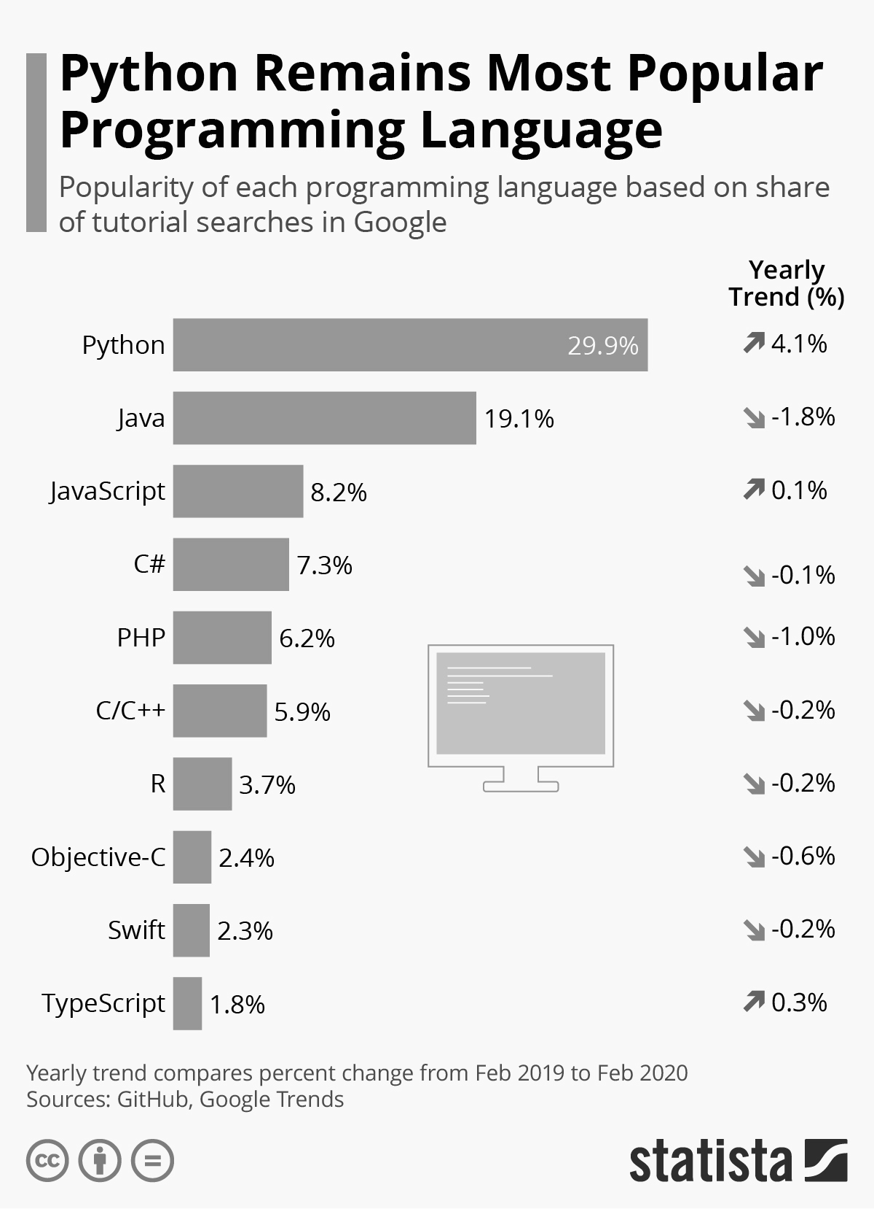
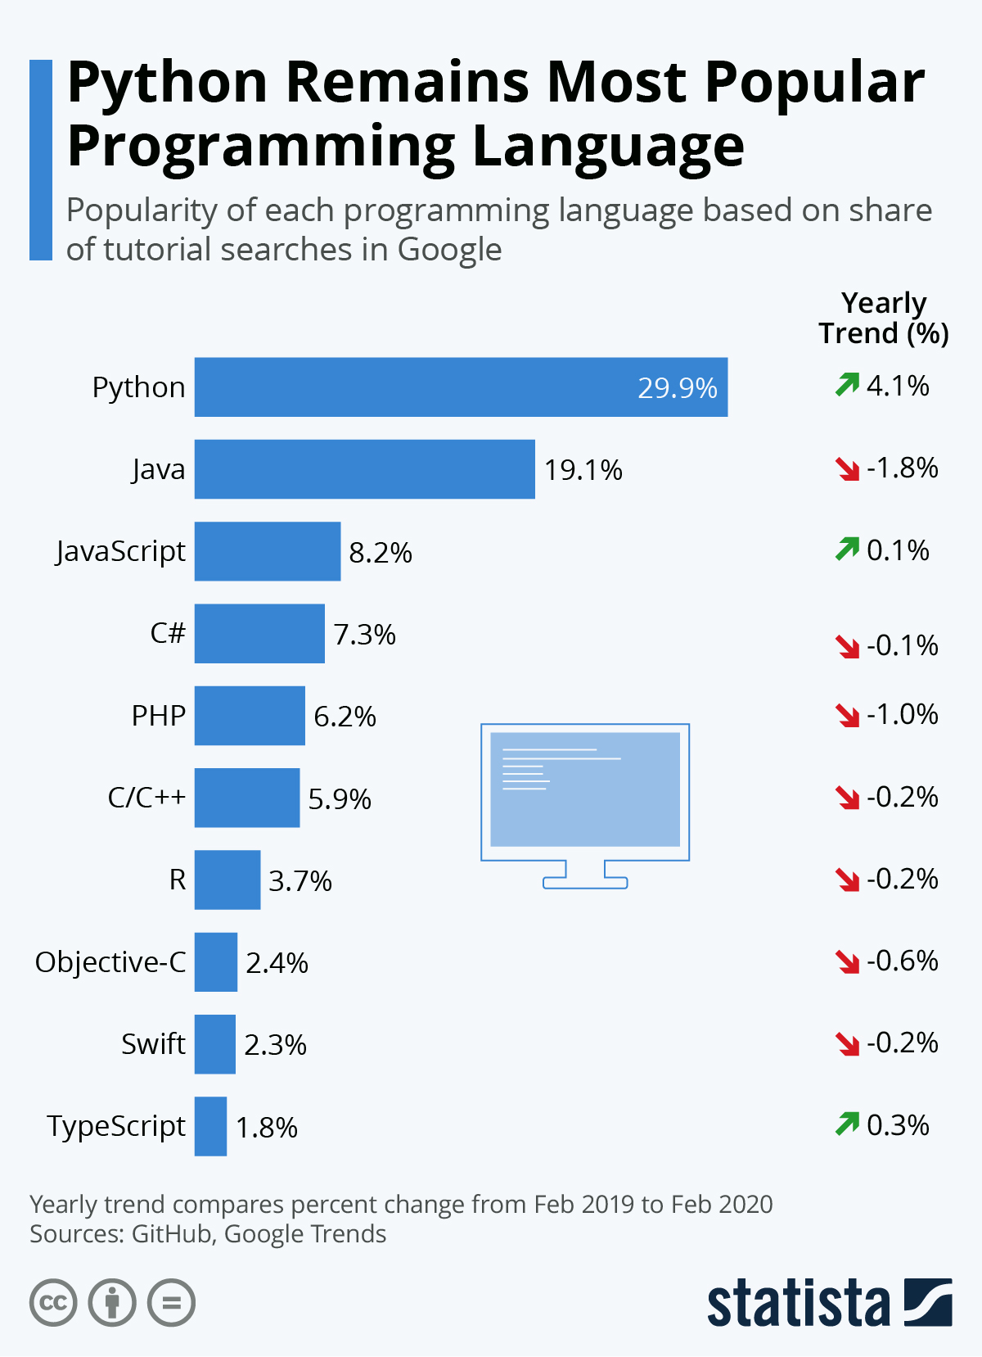
Why Learn Java?
Java is one of the most widely taught languages (including in CSC212!!)
Java is an industrial strength language that can be used to build large systems by large groups
If you know Java learning C++, etc. is easy!

Slide 10
Let’s compare…
multi-paradigm
interpreted language
with dynamic typing
and automatic memory management

Slide 11
Let’s compare…
an object-oriented
compiled language
with strong static typing
and automatic memory management

Slide 12
First big difference
an object-oriented
compiled language
with strong static typing
and automatic memory management

Slide 13
Compiled vs. interpreted languages
 | COMPILER | INTERPRETER
What it takes in: | an entire program | a single line of code (or a single instruction)
What it returns: | intermediate object code (e.g. classes) | <nothing>
Relative speed: | faster | slower
Memory usage: | uses more memory (↑ objects take space ↑) | uses less memory (no intermediate objects)
Work is done: | just once | every time the code is executed
Reports errors: | after checking the entire program | after each instruction is run

Slide 14
Next big difference
an object-oriented
compiled language
with strong static typing
and automatic memory management

Slide 15
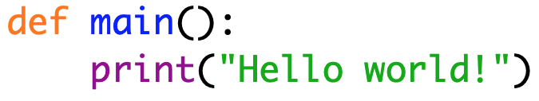
Example: hello world

Slide 16
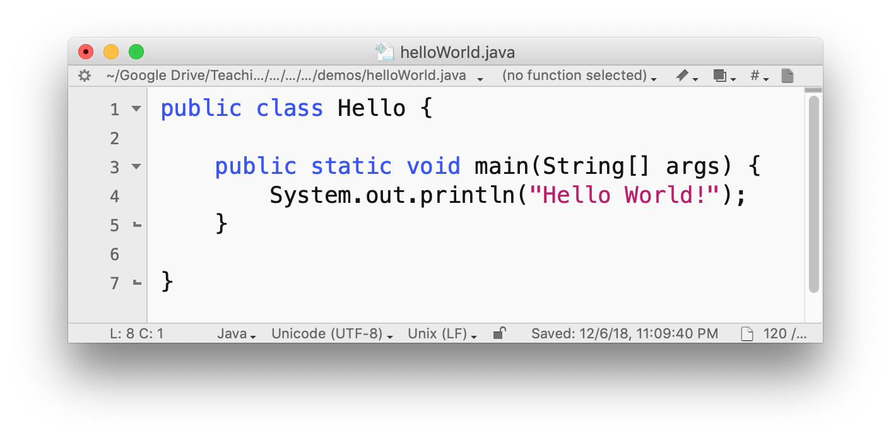
Example: hello world

Slide 17
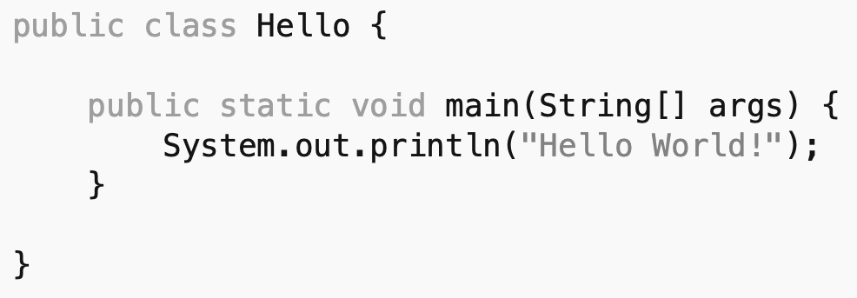
Several similarities…

Slide 18
Several similarities…
a built-in function
to output stuff to the console

Slide 19
Some minor differences…
curly braces indicate containment
(instead of tabs)
(in fact, we could any Java program on a single line!)

Slide 20
Some more significant differences…
can’t do anything
without a class
(in fact, we could any Java program on a single line!)

Slide 21
Some more significant differences…
seems like we have to give
a bunch more information
about our function / class definitions
(in fact, we could any Java program on a single line!)

Slide 22
Discussion
So how to we run it?

Slide 23
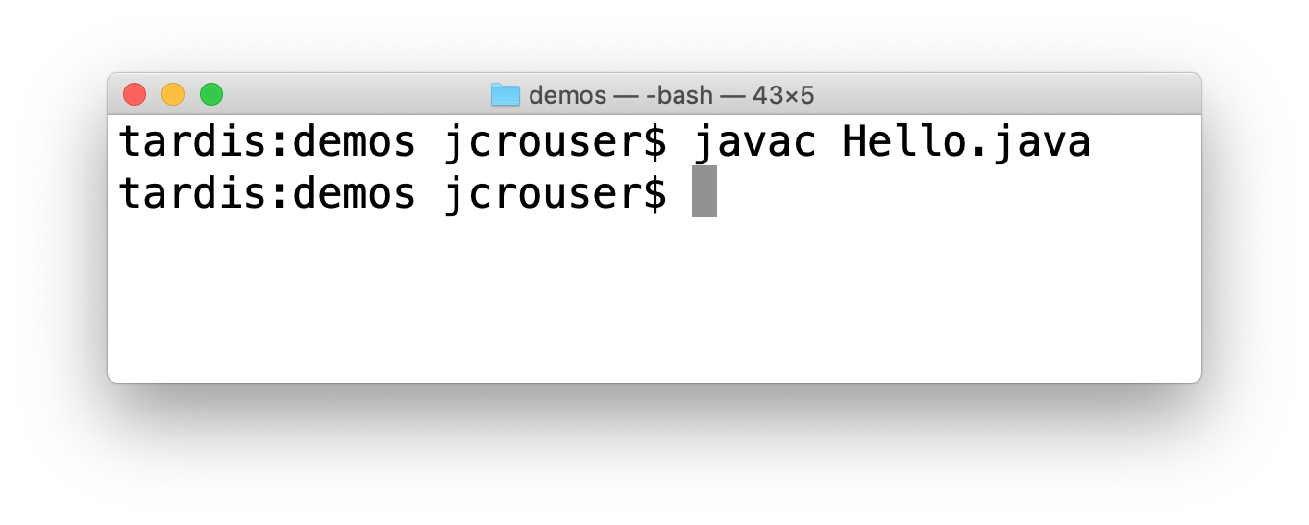
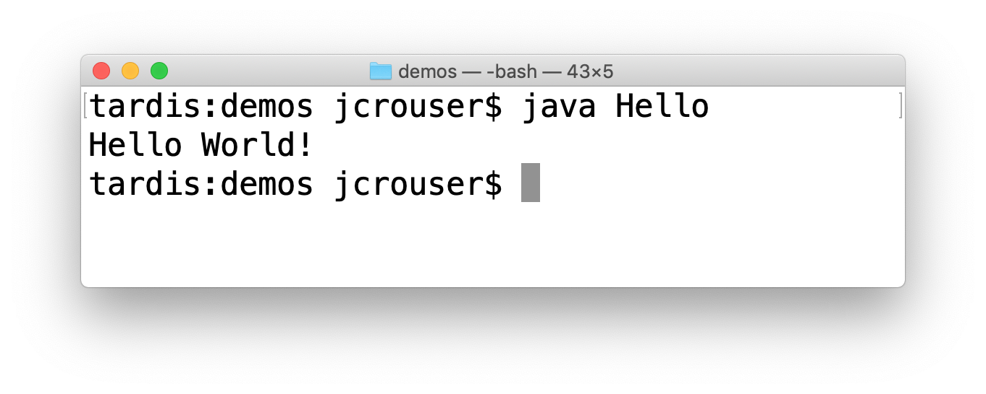
Two-step process
Remember: java is a compiled language
Step 1: compile
Step 2: run
Notes:
The job of the compiler is to turn your java code into language that the Java Virtual Machine (JVM) can understand.
We call the code that the JVM understands byte code.
The JVM interprets the byte code much like the Python interpreter interprets your Python.
However since byte code is much closer to the native language of the computer it can run faster.

Slide 24
Basic rules of Java
Every Java program must define a class:
all code is inside the class
the file has the same name as the class
Everything in Java must have a type (nothing is assumed)
Every Java program must have a function called
public static void main(String[] args)
see why we developed
this habit early?

Slide 25
Java: be specific!
public static void main(String[] args)
Notes:
Let’s unpack this definition a little bit

Slide 26
Java: be specific!
public static void main(String[] args)
we can call this method
from outside the class
Notes:
Let’s unpack this definition a little bit

Slide 27
Java: be specific!
public static void main(String[] args)
the method belongs to the class,
but not any one instance

Slide 28
Java: be specific!
public static void main(String[] args)
the method doesn’t
return anything

Slide 29
Java: be specific!
public static void main(String[] args)
the method takes an
array (list) of Strings
as input

Slide 30
And the line that does the actual work?
System.out.println(“Hello world!”);

Slide 31
And the line that does the actual work?
System.out.println(“Hello world!”);
this is a
built-in object

Slide 32
And the line that does the actual work?
System.out.println(“Hello world!”);
that object
has an attribute
(which is also an object)
Notes:
The out object is the standard output stream for this program.

Slide 33
And the line that does the actual work?
System.out.println(“Hello world!”);
that object
has a method
Notes:
The println method prints a string and adds a newline character at the end.
Anywhere in Python that you used the print function you will use the System.out.println method in Java.

Slide 34
And the line that does the actual work?
System.out.println(“Hello world!”);
every statement ends
with a semi-colon
Notes:
In Java the ; signifies the end of a statement.
Unlike Python where statements are almost always only one line long java statements can spread across many lines.
The compiler knows it has reached the end of a statement when it encounters a ;

Slide 35
Basic data types in Java
Primitive | Object
int | Integer
float | Float
double | Double
char | Char
boolean | Boolean
Notes:
One of the great things about Python is that all of the basic data types are objects.
Integers are objects, floating point numbers are objects, lists are objects, everything.
In Java that is not the case.
In Java some of the most basic data types like integers and floating point numbers are not objects.
The benefit of having these primitive data types be non-objects is that operations on the primitives are fast.
The problem is that it became difficult for programmers to combine objects and non-objects in the way that we do in Python.
So, eventually all the non-object primitives ended up with Objectified versions.

Slide 36
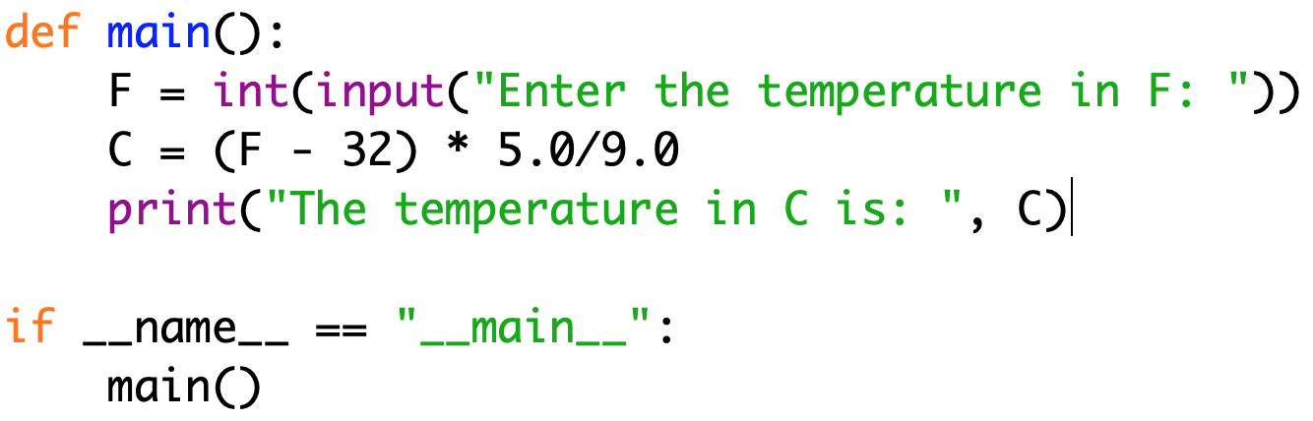
A slightly more interesting past program

Slide 37
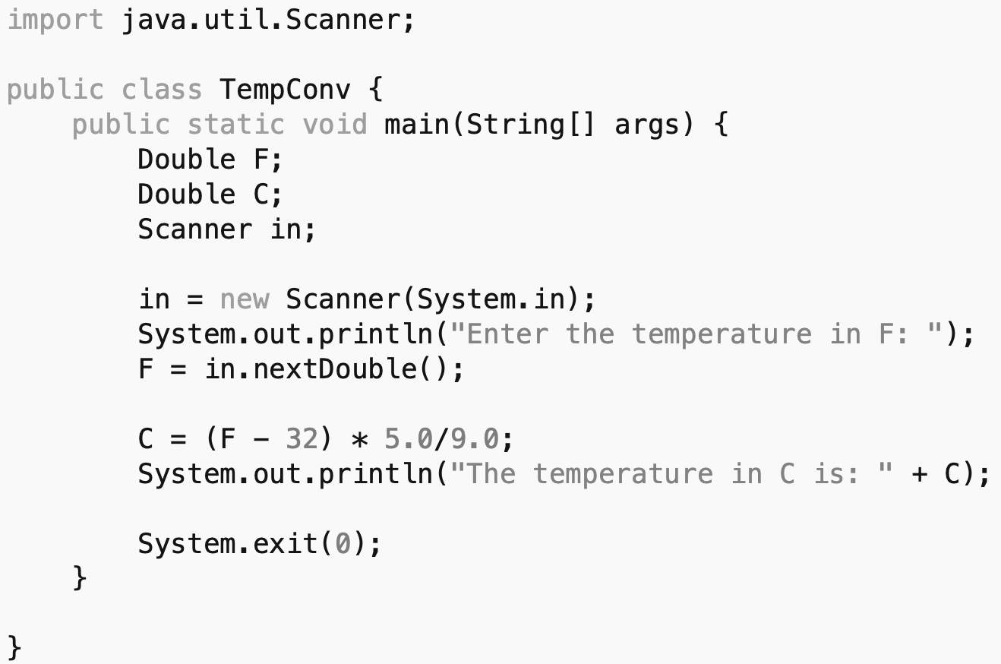
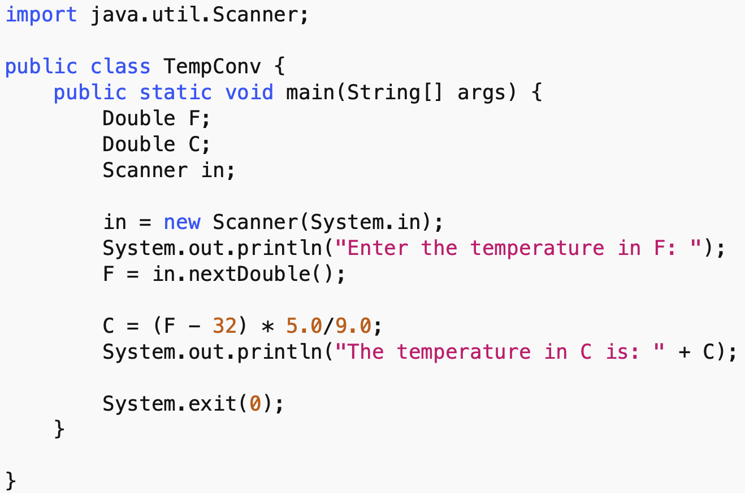
The same thing in Java

Slide 38
The same thing in Java
math looks
pretty similar
as do string
literals

Slide 39
The same thing in Java
importing works roughly the same way
(but there are WAY MORE built-in classes,
and they’re organized hierarchically!)

Slide 40
The same thing in Java
like
input(…)

Slide 41
The same thing in Java
but the
prompt
is separate

Slide 42
The same thing in Java
as is the call
to get the
actual input

Slide 43
Declaring variables
unlike python,
we have to
tell Java
in advance
what type
each variable
will be

Slide 44
Declaring variables
unlike python,
we have to
tell Java
in advance
what type
each variable
will be

Slide 45
Cleaning up
it’s generally good practice to
close the JVM when you’re done
(the 0 means “zero errors”)

Slide 46
Discussion
Does this look like any Java applications
you’ve encountered?

Slide 47
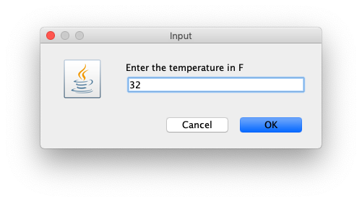
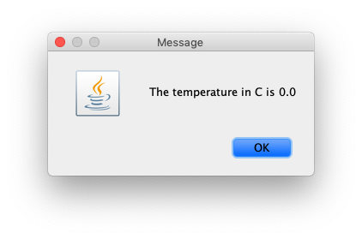
A more realistic Java program

Slide 48
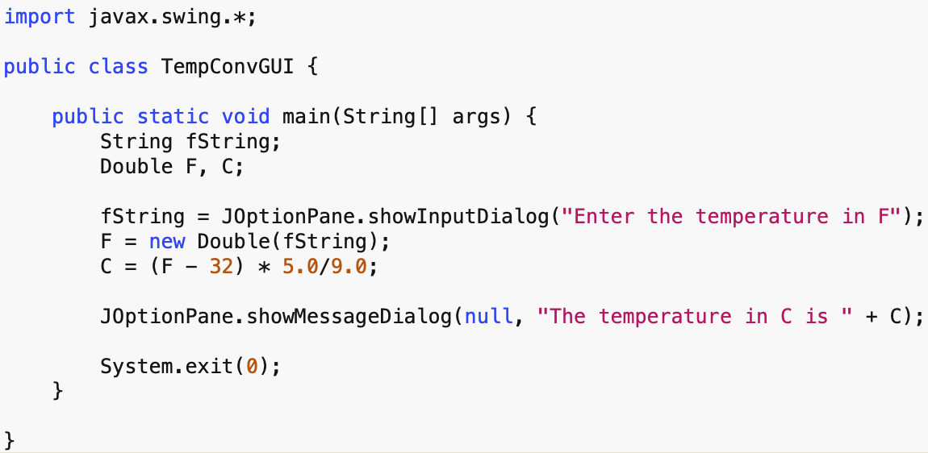
Not a problem!

Slide 49
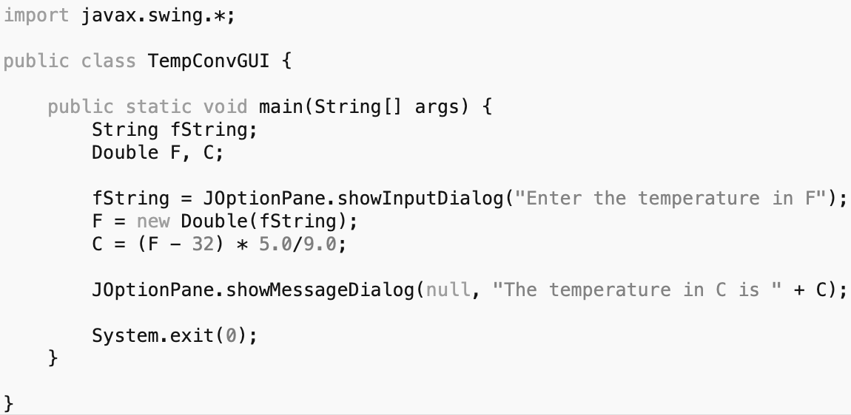
Not a problem!
javax.swing is the Java equivalent
of tkinter (graphics)

Slide 50
Not a problem!
which gives us input
dialog boxes

Slide 51
Not a problem!
as well as
output dialog boxes
(and much, much more!)

Slide 52
Big takeaways
Just like spoken languages, there are many different programming languages - each expressive in its own way
This semester, you learned fundamental ideas in computer science (using Python as a medium):
variables
loops
conditional statements
functions
…and many more!
These fundamental ideas are still valid in other languages!

